Slide 1
HAPPY BIRTHDAY TO OFS KOREA 75 YEARS OF JOURNEY WITH FRANCIS AND CHRIST

Slide 2
GREETINGS FROM THE SISTERS AND BROTHERS IN INDONESIA

Slide 5
OFS Yakoba, Cipanas, Indonesia

Slide 7
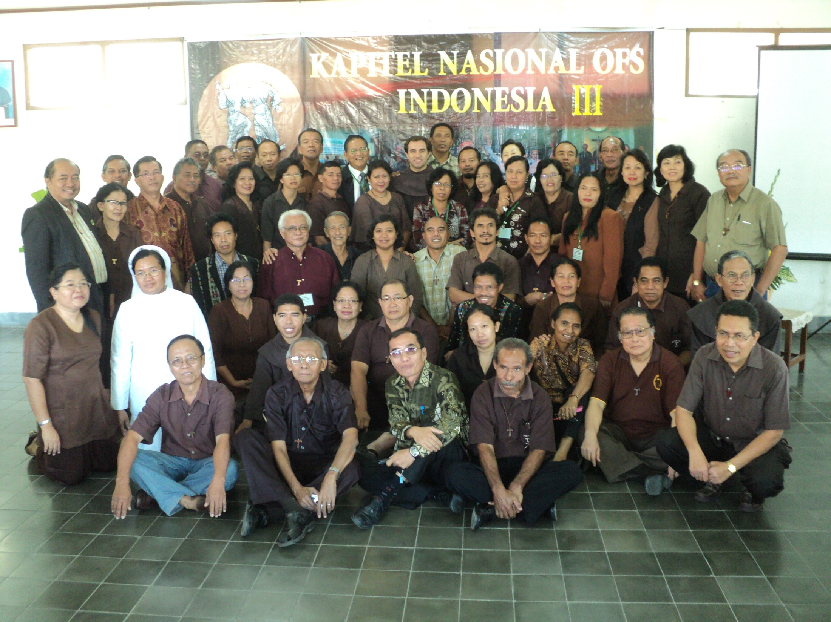

Slide 9
DEWAN NASIONAL OFS INDONESIA
Pendamping Rohani I : Pater Yan Ladju, OFM Pendamping Rohani II: Pater Donatus Marbun, OFMCap. Minister Nasional: Sdr. Nikolaus Namai, OFS Wakil Minister Nasional: Sdr. Anton Susanto Sitohang, OFS Sekretaris Nasional: Sdri. Christina Chang, OFS Bendahara Nasional: Sdri. Dianawati Salim, OFS Formator Nasional: Sdr. F.X. Indrapradja, OFS International Councillor: Sdr. F.X. Indrapradja, OFS Vice International Councillor: Sdr. Elias Laia, OFS

